Slide 1
PROJECT
ON
ONLINE SHOPPING
ENTITLED eMart
The easy way to shop online and explore all around market sitting at home
Project Created & Presented By:
Siddhant Aggarwal
2374
CSE-B(4TH YEAR)
DITM

Slide 2
OBJECTIVES
To provide users at ease of selling and buying.
To provide them a simple and efficient list of products from all around the country.
To provide them more chance of selling their products.
To help them by saving their every transaction on the go.
To help them provide with more varieties and various new trends in market sitting at home.

Slide 3
TECHNOLOGIES USED
FRONT END
HTML
CSS
JAVASCRIPT
BACK END
PHP
AJAX
MYSQL DATABASE

Slide 4
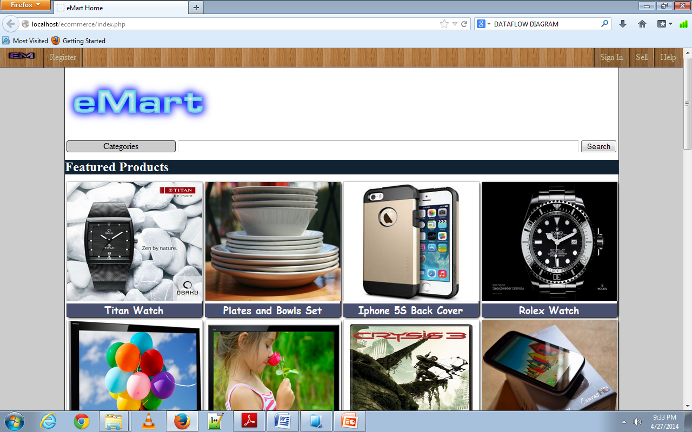
HOME PAGE OF WEBSITE
This page shows the randomized list of products posted on our website
On hover category list view
Search box to search for specific products

Slide 5
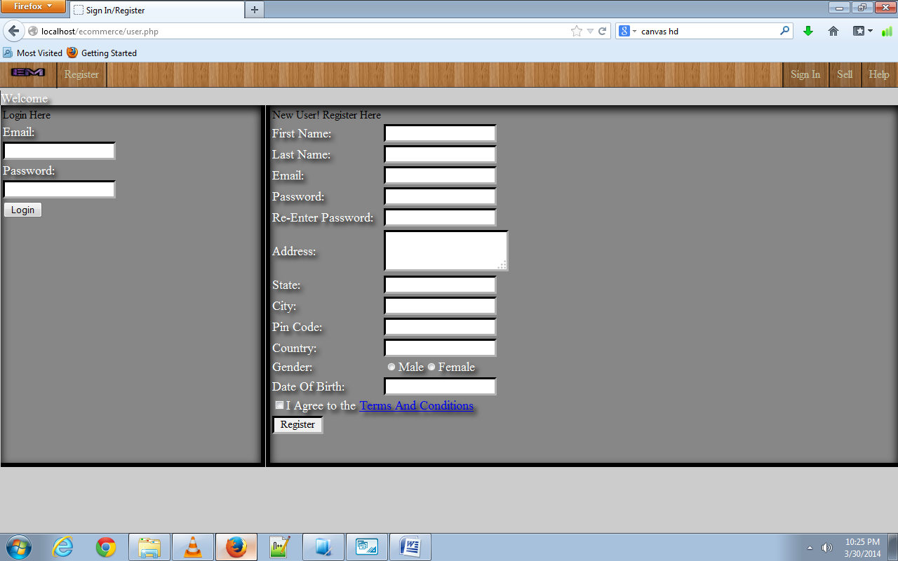
REGISTRATION PAGE OF WEBSITE
This page allows user to register or login
Email Id is kept unique and used for login
Atleast 6 characters long password required

Slide 6
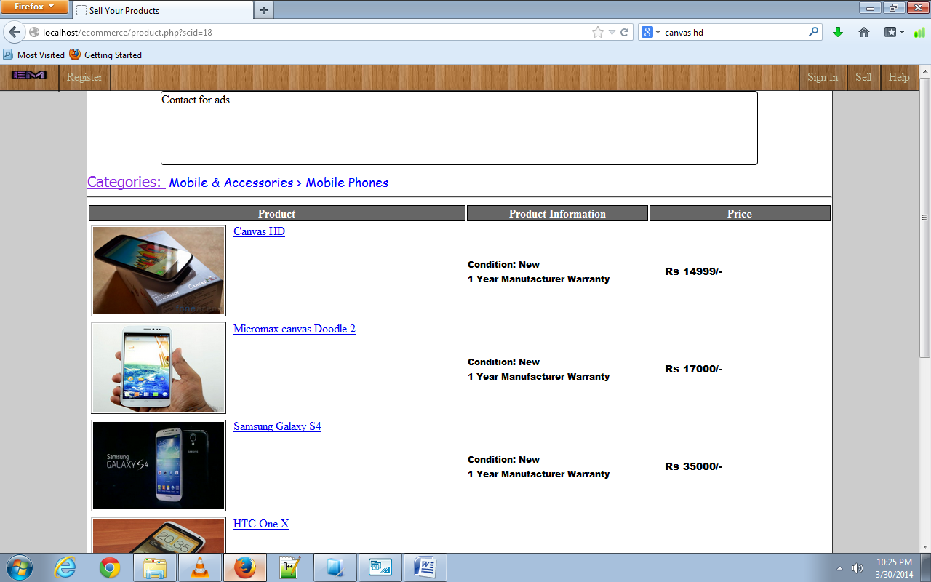
PRODUCT DISPLAY PAGE OF WEBSITE
This page shows the categorized list of products selected by the user
Shows product image, name, condition, warranty and price
Clickable Image and name for more information.

Slide 7
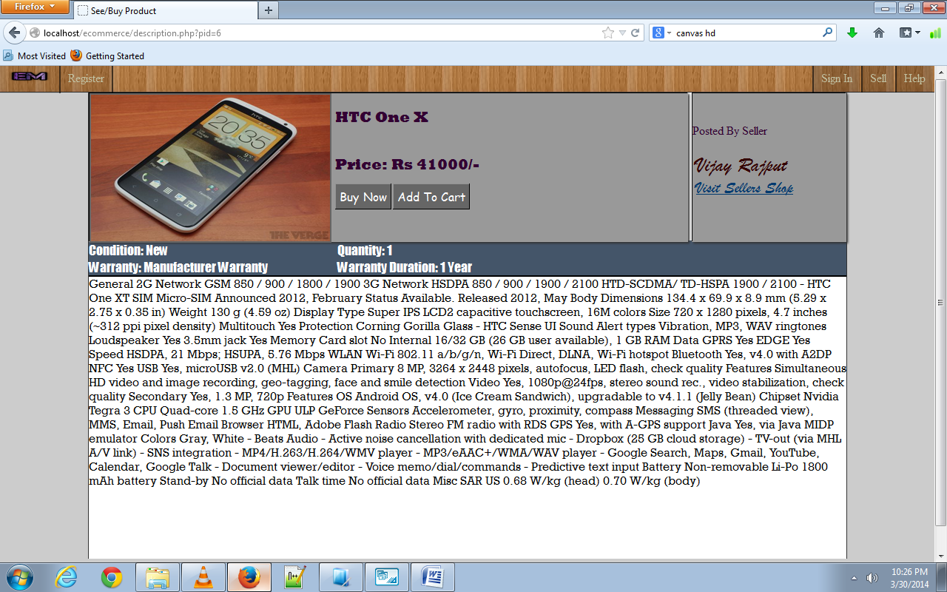
PRODUCT DESCRIPTION PAGE OF WEBSITE
This page shows full information related to the product such as condition, seller, price, etc
Includes Link to seller’s shop
Also includes Buy Now and Add To Cart options

Slide 8
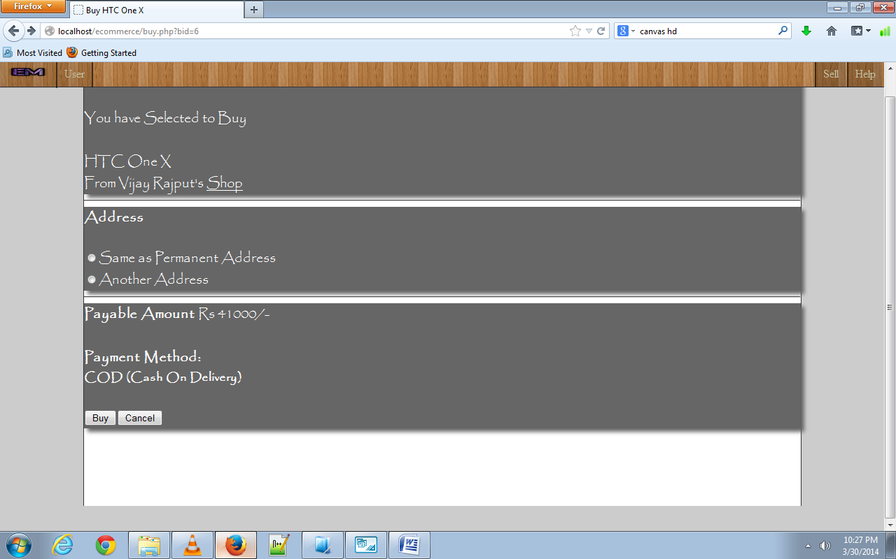
BUY CONFIRM PAGE OF WEBSITE
This page shows the confirmation for buying the product
Allow option to specify address
Show the payment amount and method
Buy and Cancel button

Slide 9
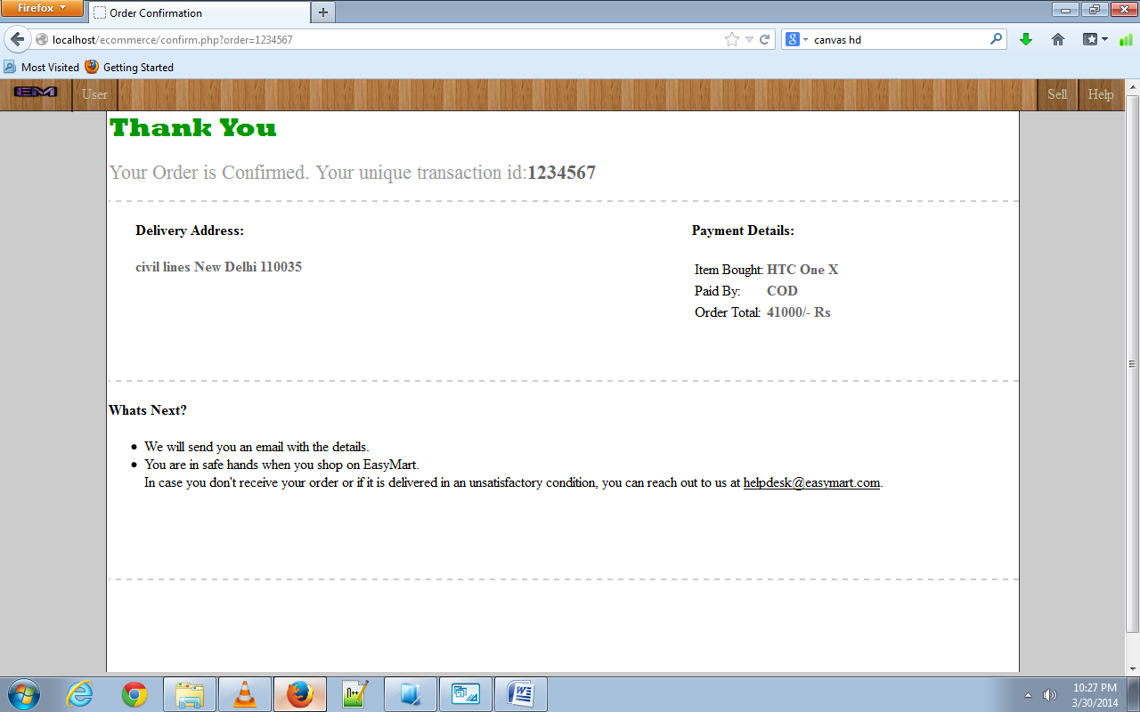
BUY PAGE OF WEBSITE
This page shows the confirmation of buy product with a unique transaction id
Show the delivery address and payment details

Slide 10
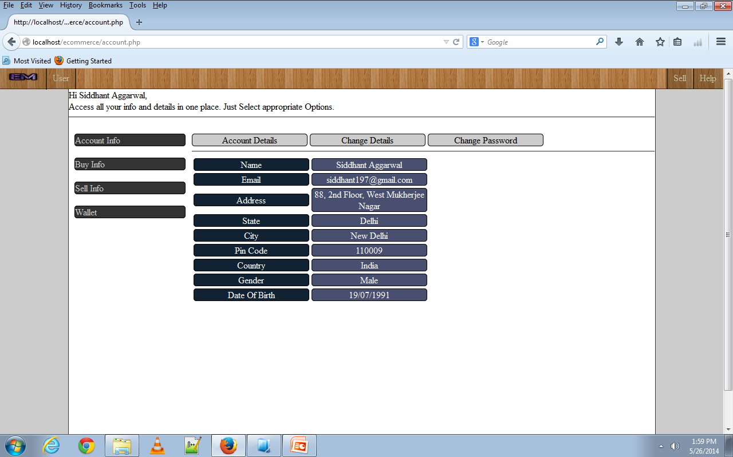
ACCOUNT PAGE OF USER
This page shows all the details related to account
Give options to check for products that have been bought by the user
Also to check which items have been posted and sold by him/her
Option to change account info and password
Wallet feature to add cash in advance

Slide 11
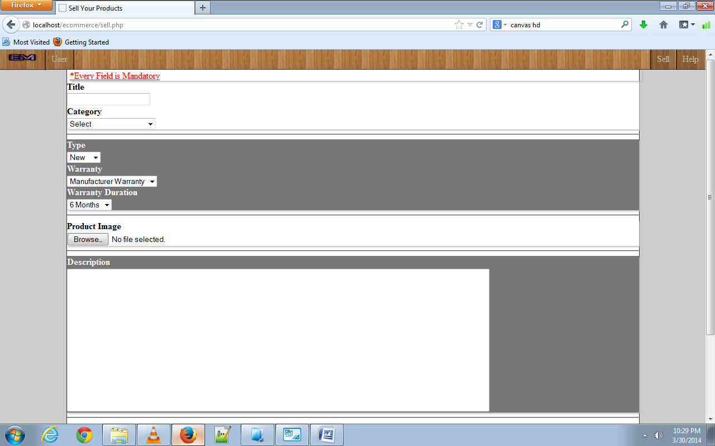
SELL PAGE FOR USER
This page allow user to post product for selling
Entering product information such as name, category, subcategory, condition, warranty, image and description

Slide 12
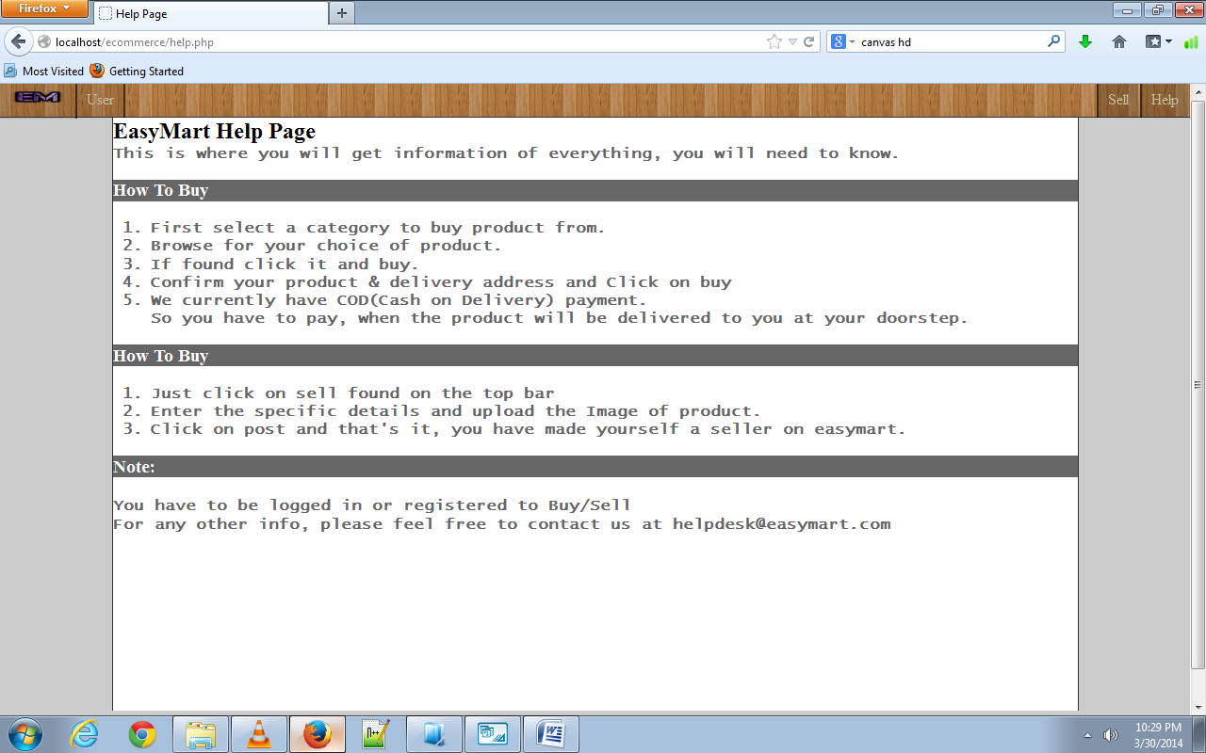
HELP PAGE FOR USER
This page allow information needed for new user for selling and buying products

Slide 13
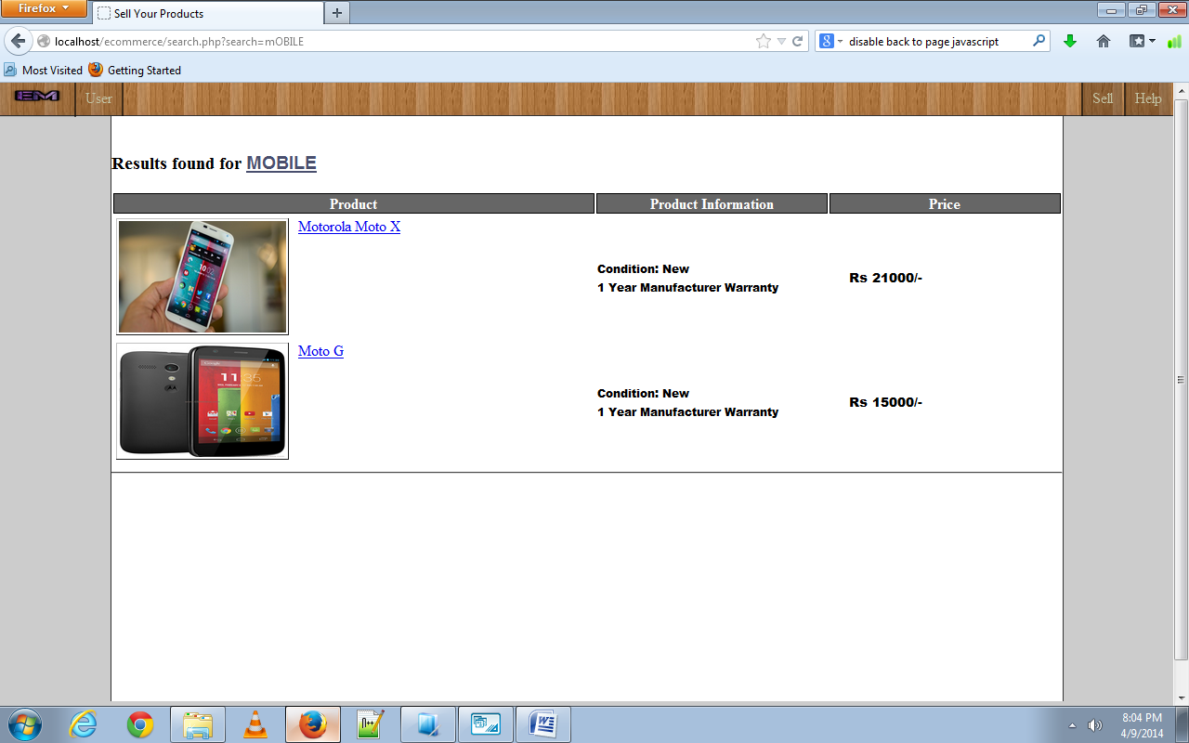
RESULT PAGE FOR SEARCH
This page show results for the searched text
Search results are on basis of product name or description

Slide 14
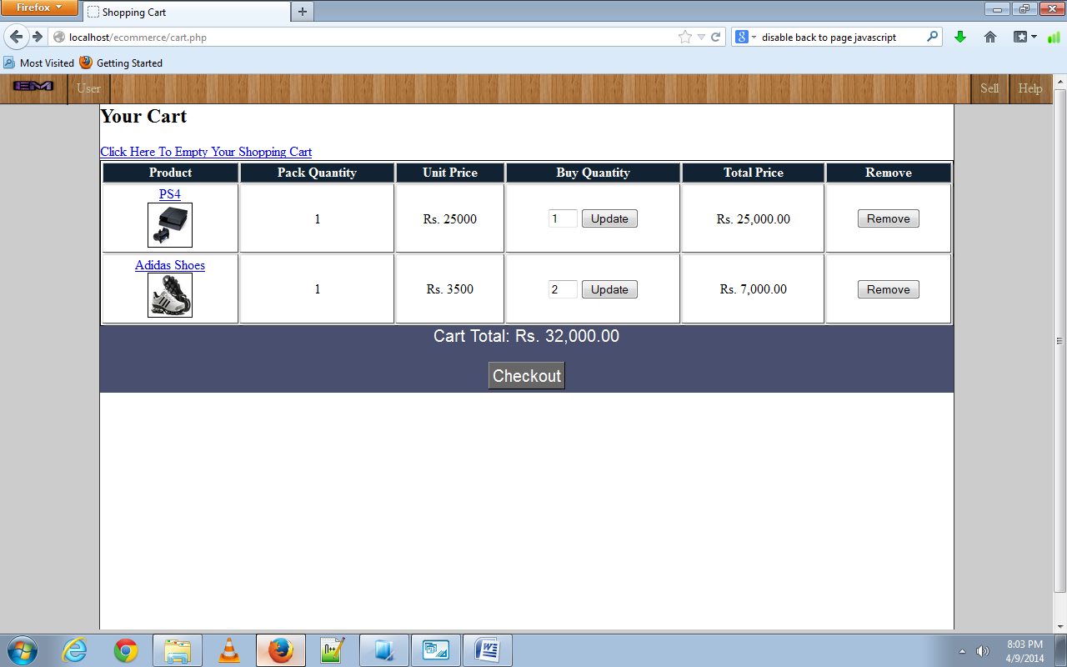
ADD TO CART PAGE FOR USER
This page show products added to cart
Used a Session array to store & show items
This page also has options to empty shopping cart, change quantity, remove a specific item and show total

Slide 15
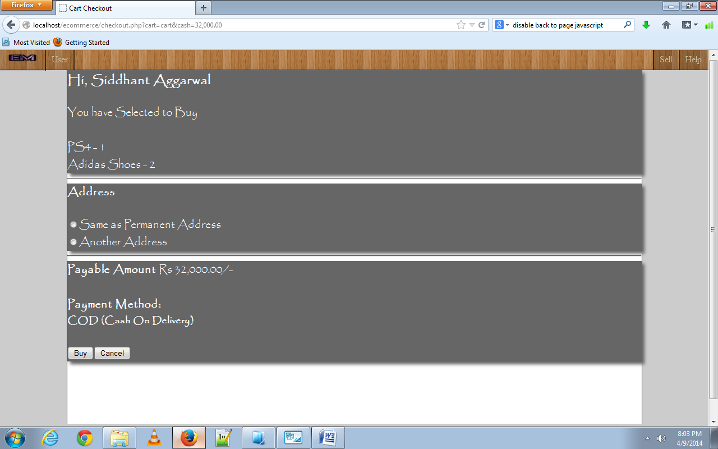
CHECKOUT PAGE FOR CART
This page shows the confirmation for buying the products in cart
Allow option to specify address
Show the total payment amount and method
Buy and Cancel button

Slide 16
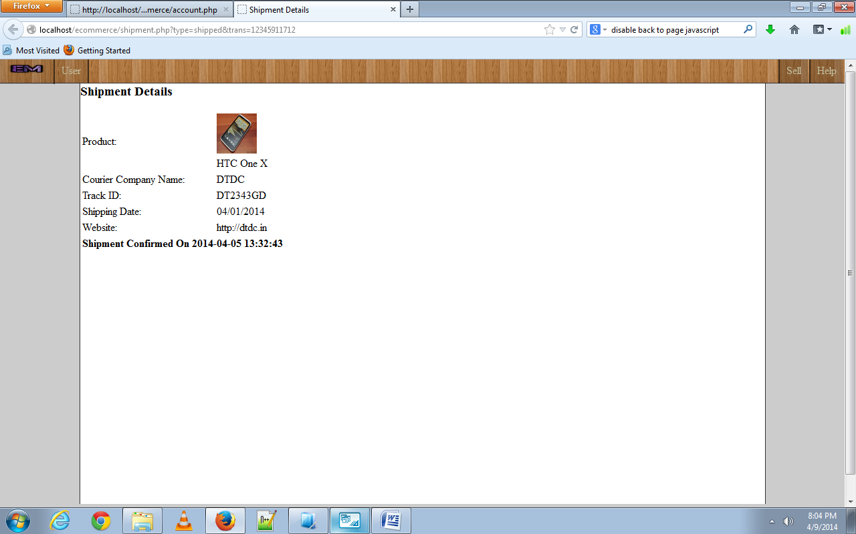
SHIPMENT PAGE FOR BUYER AND SELLER
This page allows the user to update shipment details regarding the products sold
Allow buyer to know the shipment details such as courier name, track number and website
Also allows buyer to confirm delivery or complaint for a refund

Slide 17
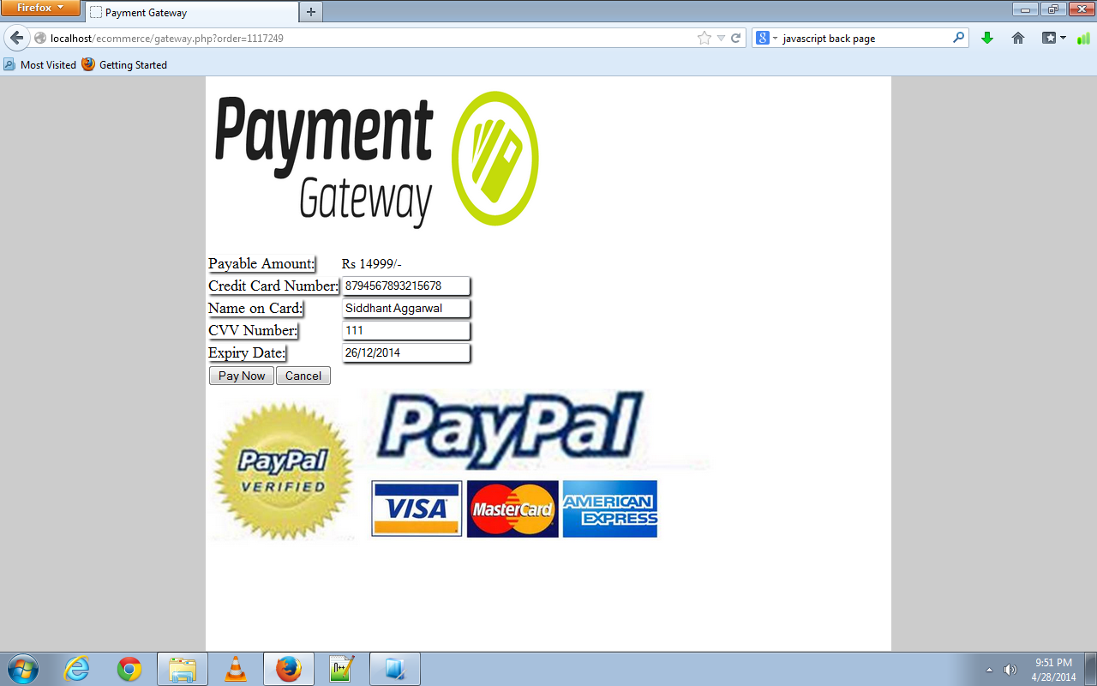
PAYMENT GATEWAY FOR ONLINE PAYMENTS
This page allows the user’s to pay online through credit/debit card
Allow 16 digit card number, 3 digit number and other details

Slide 18
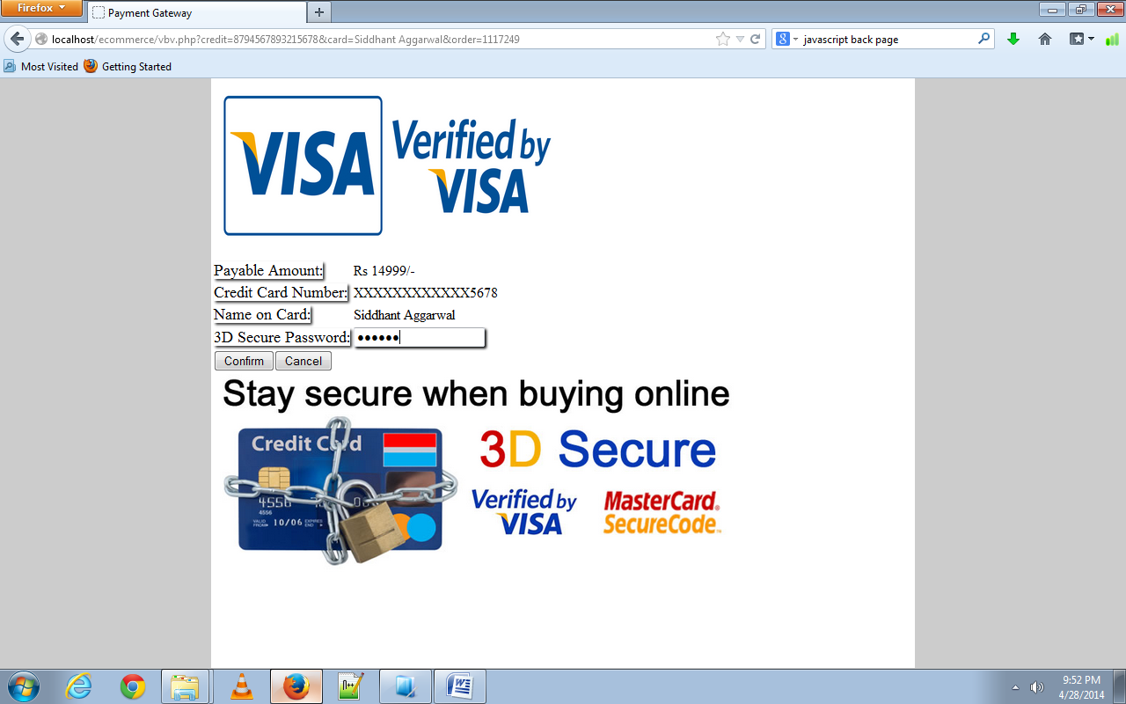
VERIFIED BY VISA PAGE
This page comes after payment gateway
Enter verified by visa 3D secure password

Slide 19
CONCLUSION
With this project, the efforts made to perform the required operations are reduced.
One can easily shop online in future reference.
Once online, this website can be accessed on any platform.

Slide 20
FUTURE SCOPE
It ensures user friendly and easy to use website with quality products that can be purchased.
eMart website also provides provisions for administrator to easily manage the content of the website.
It reduces human efforts and resources (transport) to go to shops and buy products or sell their products.
In this very busy lifestyle this system can save the precious time of the customers by obviating the requirement of going to a shop in a heavy traffic.
Today’s world is definitely a world of internet, there is a computer in almost every second home and this radio will further improve in few years. So, it’s this online shopping and selling system which is going to rule in the future.

Slide 21
BIBLIOGRAPHY
Website Forums - PHP and jQuery.
Websites – www.google.com, www.w3schools.com, www.wikipedia.com, www.youtube.com, www.jquery.com.
For textbooks - Head First with PHP, Head First with HTML and CSS.

Slide 22
Thank You

